Slide 1
M5 Demand
Forecasting
Weeks 7- 9
Chyna Adams • Yanet Assefa
Notes:
Good morning/afternoon everyone. We are Chyna Adams and Yanet Assefa presenting our progress on the M5 Walmart Demand Forecasting data warehouse project for Weeks 7, 8, and 9.

Slide 2
Roles
Data Acquisition
& Profiling Lead
Warehouse
Design Lead
Chyna Adams
Yanet Assefa
2
Notes:
Chyna handled all database and warehouse implementation. Yanet handled data acquisition, profiling, quality checks, and documentation.

Slide 3
Sprint goals
• Create SQL Table Scripts
• Define Primary & Foreign Keys
• Plan the ETL Workflow
• Reshape the Sales Dataset
• Expand the Data Dictionary
• Confirm Join Keys
Notes:
These were our sprint goals for Weeks 7 through 9. We accomplished all six of them successfully.

Slide 4
What we accomplished
Chyna
PostgreSQL schema — 2 staging, 3 dimension, 2 fact tables with PKs, FKs & indexes
Chyna
Loaded calendar.csv (1,969 rows) and sell_prices.csv (6.8M rows) into staging tables
Chyna
Python ETL script — unpivoted and loaded 58,327,370 rows into fact_sales_daily
Yanet
Profiled all 3 raw CSV files — verified row counts, column counts, and file sizes
Yanet
Zero nulls, duplicates, negative values, or type mismatches found across all files
Yanet
Updated data dictionary in GitHub with all 6 key column definitions
4
Notes:
Pink rows are Chyna warehouse work. Teal rows are Yanet data preparation work.

Slide 5
Star Schema Design
Chyna — 5 tables, 2 facts, 3 dimensions
dim_date
fact_sales_daily
dim_item
PK d
date
wm_yr_wk
weekday
month / year
event_name_1
event_type_1
snap_CA
snap_TX
snap_WI
PK item_id + store_id + d
FK → dim_item
FK → dim_store
FK → dim_date
units_sold ≥ 0
PK item_id
dept_id
cat_id
dim_store
fact_price_weekly
PK store_id
state_id
PK item_id + store_id + wm_yr_wk
FK → dim_item • FK → dim_store
sell_price > 0
5
Notes:
This is our complete star schema. Gold boxes are fact tables. Teal boxes are dimension tables. Every fact row connects to all dimensions through foreign keys.

Slide 6
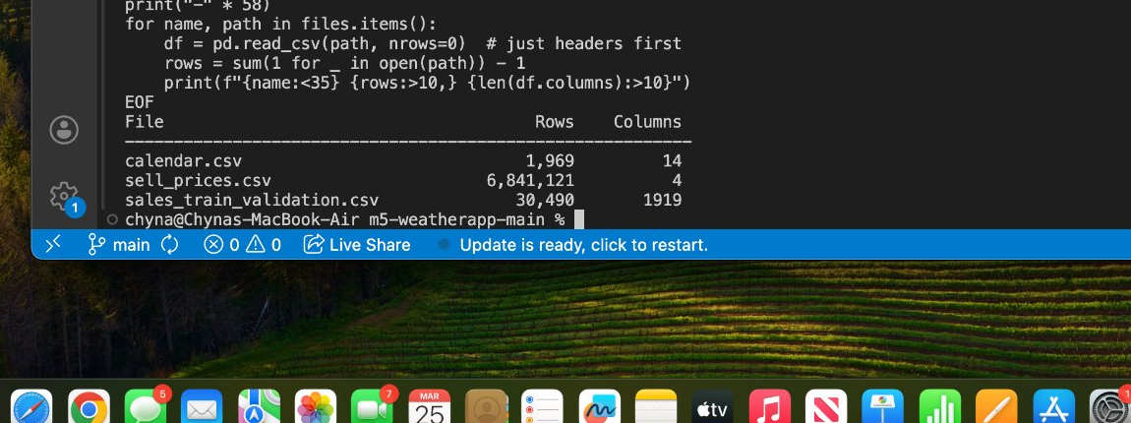
Evidence — File Profiling
Chyna profiled all 3 raw CSV files — confirmed row counts and column counts
1,969
6.8M
Calendar
rows
Price
records
30,490
1,919
Sales rows
(wide)
Day
columns
6
Notes:
Yanet ran profiling scripts on all three raw CSV files confirming exact row and column counts. The sales file has 1,919 columns — one per day — which is why transformation was required.

Slide 7
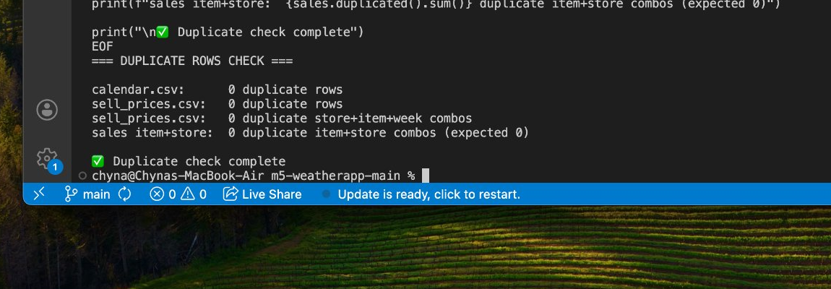
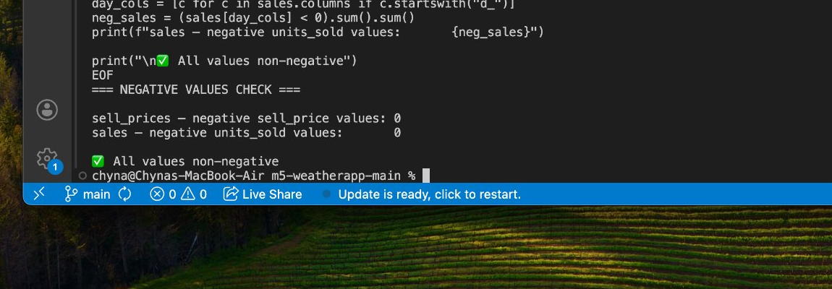
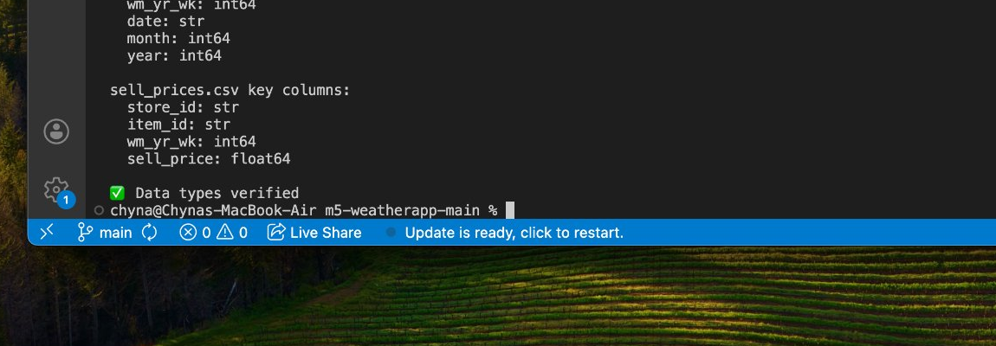
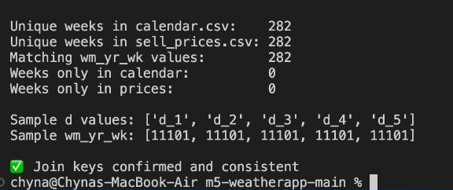
Evidence — Chyna’s Quality Checks
All 4 checks passed with zero issues ✔
✔ Duplicate Rows Check
✔ Negative Values Check
✔ Data Type Verification
✔ Join Key Confirmation
7
Notes:
All four quality checks passed with zero issues. Duplicate check, negative values check, data type verification, and join key confirmation all came back clean.

Slide 8
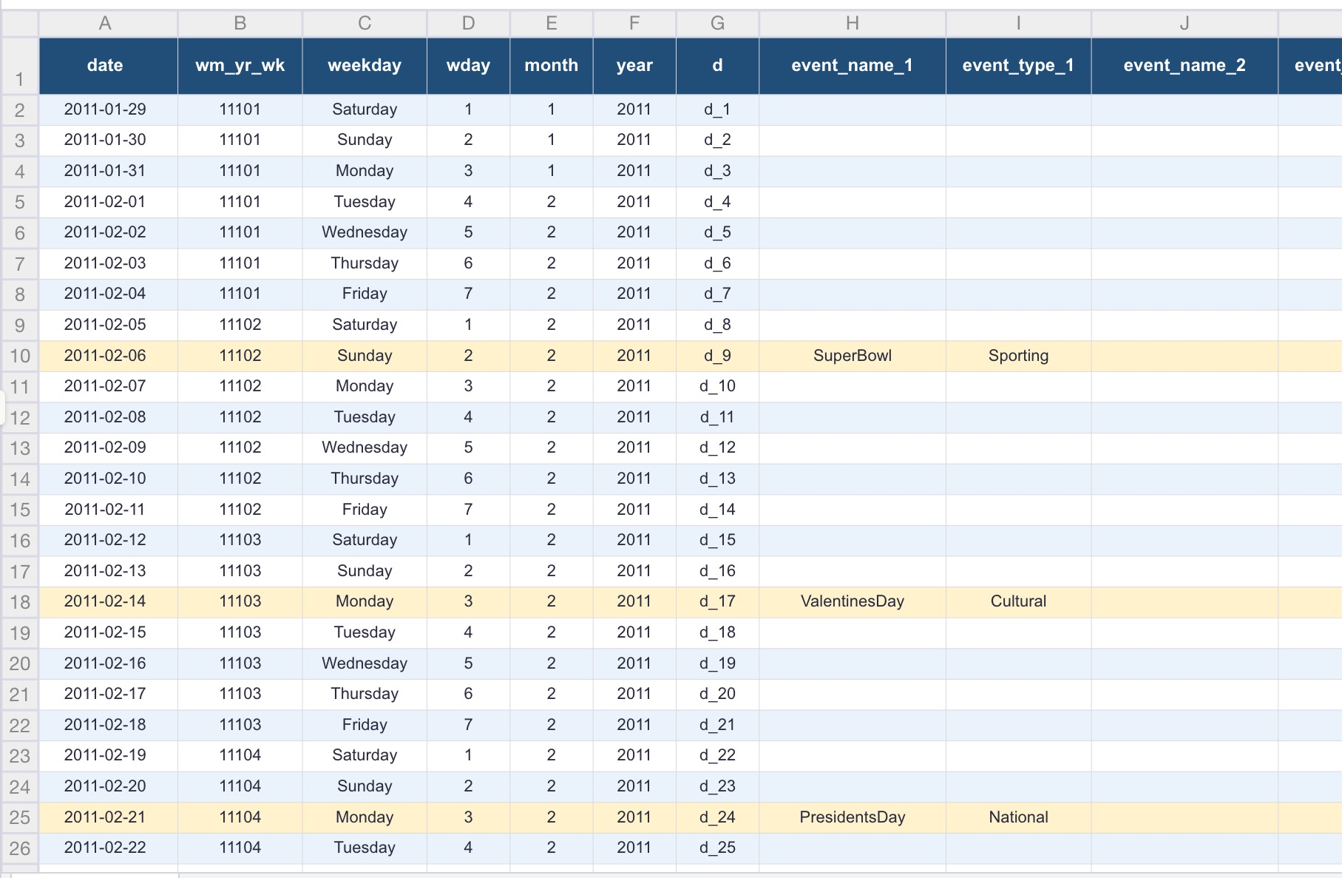
Evidence — Calendar Data Sample
Yanet opened and verified calendar.csv — shows d, wm_yr_wk, date, weekday, and event columns
wm_yr_wk
Links to
price data
d column
Links to
sales data
Events
SuperBowl
Valentines
Presidents Day
8
Notes:
This is the actual calendar.csv data Yanet opened and verified. You can see the d column which links to daily sales data, the wm_yr_wk column which links to price data, and the event columns showing holidays like SuperBowl, Valentines Day, and Presidents Day. These events will be important features in our forecasting model later.

Slide 9
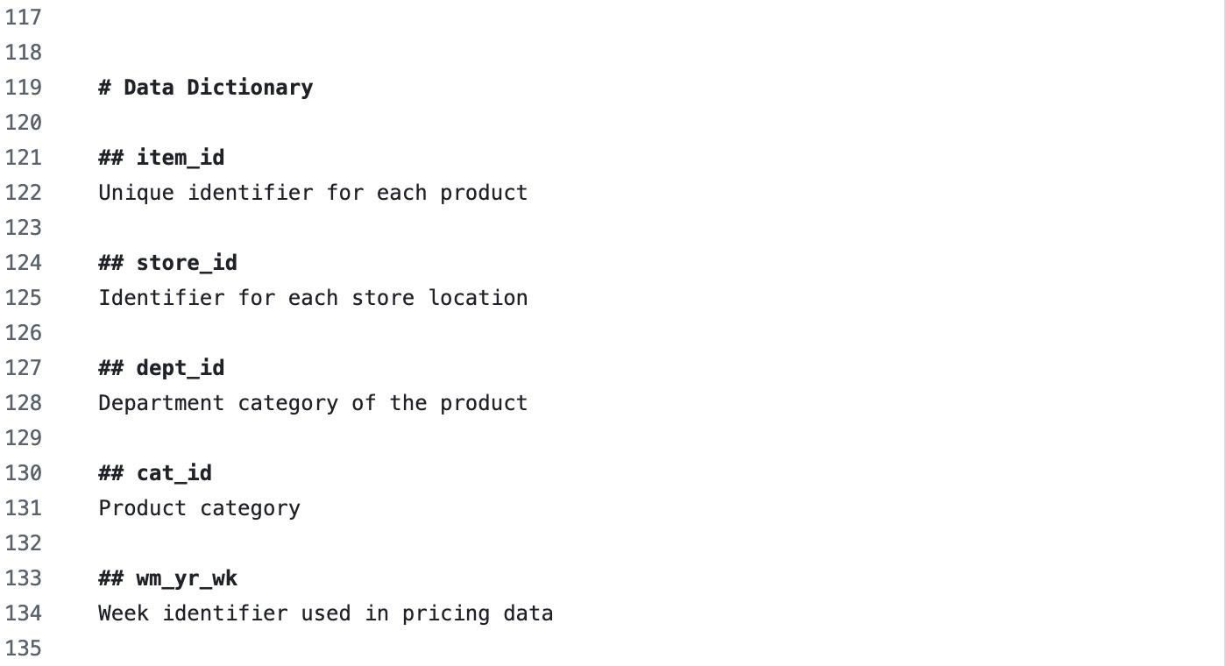
Data Dictionary
Documented by Yanet in GitHub — committed to docs/data_dictionary_draft.md
9
Notes:
On the left is the actual data dictionary file Yanet committed to our GitHub repository. On the right is a summary of the six key columns. These definitions are now part of our docs folder in the repo and serve as the reference for the whole team.

Slide 10
Data Transformation — Wide to Long
Planned by Yanet • Implemented by Chyna using Python pandas .melt()
BEFORE — Wide Format
AFTER — Long Format
item_id | store_id | d_1 | d_2 | d_3
item_id | store_id | d | sold
ITEM_1 | CA_1 | 3 | 0 | 1
ITEM_1 | CA_2 | 0 | 2 | 4
ITEM_2 | CA_1 | 1 | 1 | 0
ITEM_1 | CA_1 | d_1 | 3
ITEM_1 | CA_1 | d_2 | 0
ITEM_1 | CA_1 | d_3 | 1
ITEM_1 | CA_2 | d_1 | 0
...
→
❌ 1,919 separate day columns
❌ Cannot load into warehouse
❌ Hard to query or analyze
✔ One row per item × store × day
✔ Matches warehouse grain exactly
✔ 58,327,370 rows loaded ✅
10
Notes:
Yanet identified the wide format problem and documented the plan. Chyna implemented it with Python pandas melt, producing 58 million rows.

Slide 11
Blockers & Risks
3 resolved • 1 ongoing
✔
✔
✔
→
RESOLVED
RESOLVED
RESOLVED
WEEK 10
PostgreSQL role error
Fixed: createuser -s root
Wide format sales data
Yanet planned • Chyna coded
GitHub 100MB file limit
Fixed: raw/ added to .gitignore
fact_price_weekly empty
Staging loaded — ready to INSERT
Owner: Chyna
Owner: Both
Owner: Chyna
Owner: Chyna
11
Notes:
Three blockers fully resolved. Only open item is loading fact_price_weekly which is planned for Week 10.

Slide 12
Next Week Plan — Week 10
Owners and expected artifacts listed for each task
#
Task
Owner
Expected Artifact
1
Load fact_price_weekly from stg_sell_prices
Chyna
Confirmed row count output
2
Add performance indexes to fact tables
Chyna
Benchmark query times
3
Run formal QA script → save to outputs/
Chyna
outputs/qa_log.txt committed
4
Write 2+ OLAP analytics queries
Yanet
sql/queries/*.sql committed
5
End-to-end join: sales + calendar + prices
Yanet
Screenshot of join output
12
Notes:
Week 10 plan with clear owners and deliverables. Pink rows are Chyna tasks completing the warehouse. Teal rows are Yanet tasks writing analytics queries.

Slide 13
Thank
You!
Chyna Adams • Yanet Assefa
Notes:
Thank you! Happy to answer any questions.

